Slide 1

PES’s Modern College of Engineering, Department of Information Technology
Stock Candle
Project Group ID : 06
Guide : Prof. Yogita Fatangare
Group Members
1. Utkarsha M Abhang (45001)
2. Piyush S Adhalikar (45002)
3. Atharva M Mulay (45051)
4. Anushka M Mulay (45050)

Slide 2
Introduction
It represents the residual assets of the company.
Stock market prediction is the act of trying to determine the future value of a company stock or other financial instrument traded on an exchange.
The successful prediction of a stock's future price could yield significant profit.
The result of the analysis is predicted with the help of fbprophet.
Complex machine learning algorithms such as deep learning methods can analyze and detect complex data patterns.

Slide 3
Problem Statement
To predict and analyze the stock price of the company with the help of historical data and present data using
fbprophet.

Slide 4
Objective
To analyze the stock market.
To predict the price of the specific company
To predict stocks pattern and prepare pattern chart using fbprophet.
To statistically analyze extracted features from pre-processed pattern of stock.

Slide 5
Scope
User can see predictions about bank nifty.
Latest news about IPOs and FPOs.
We are using fbprophet for stock pattern and forecasting.

Slide 6
Abstract
In the era of big data, deep learning for predicting stock market prices and trends has become even more popular than before.
We have collected 7 years of (from 2015) stock data from Yahoo API and have proposed forecast data for predicting price trend of stock markets.
The proposed solution includes pre-processing of the stock market dataset, utilization of multiple feature engineering techniques, combined with a customized deep learning based system for stock market price trend prediction.

Slide 7
Modules
User
Admin
Prediction

Slide 8
1) User
When user will enter the web application, he/she will get to see the stock related videos on the home page.
Also there will be a select box, if a user searches for the stock, he/she will see the raw and forecast stock data
User can also see the monthly, weekly, yearly predictions of that stock.

Slide 9
2) Admin
Admin takes the stock data from Yahoo finance API.
Admin will train the data and forecast it with the help of fbprophet.
The data set from Yahoo finance API contains information like previous closing, opening, high, low, volume of the stock of that company.

Slide 10
3) Prediction
Using various best algorithms to improve the accuracy of stock prediction we proposes a stock price method based on fbprophet for the stock closing price of the next days.
We’ve have used plotly.graph_objs module to make up the plots.
The Prophet algorithm detects the trends from the data first, then combine them together to get the forecasted values.

Slide 11
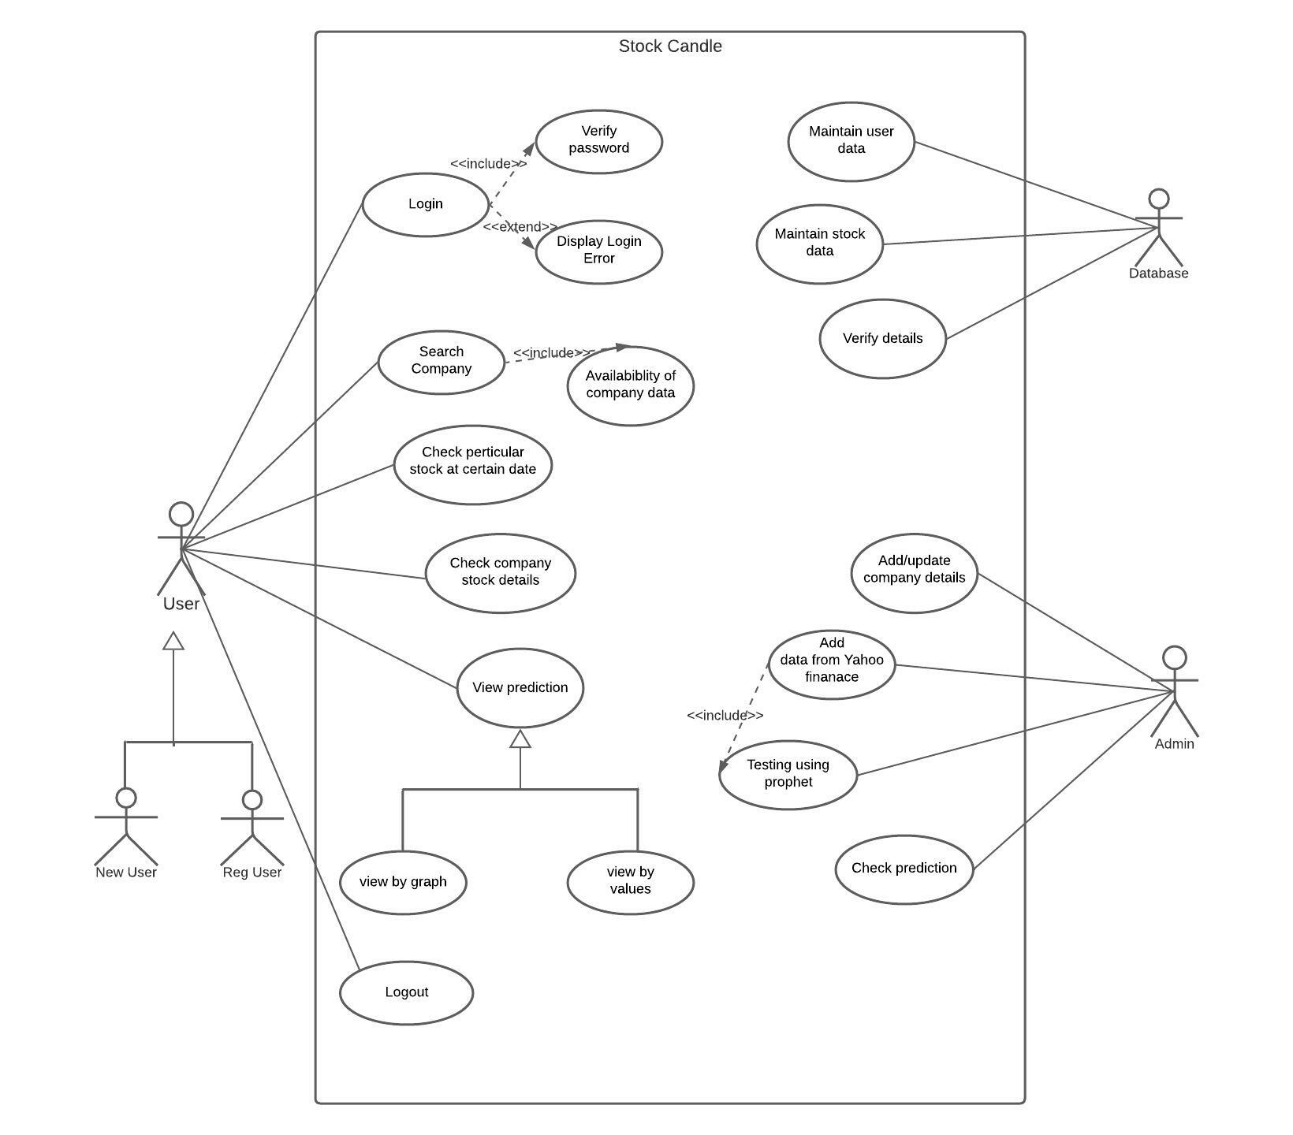
Use Case Diagram

Slide 12
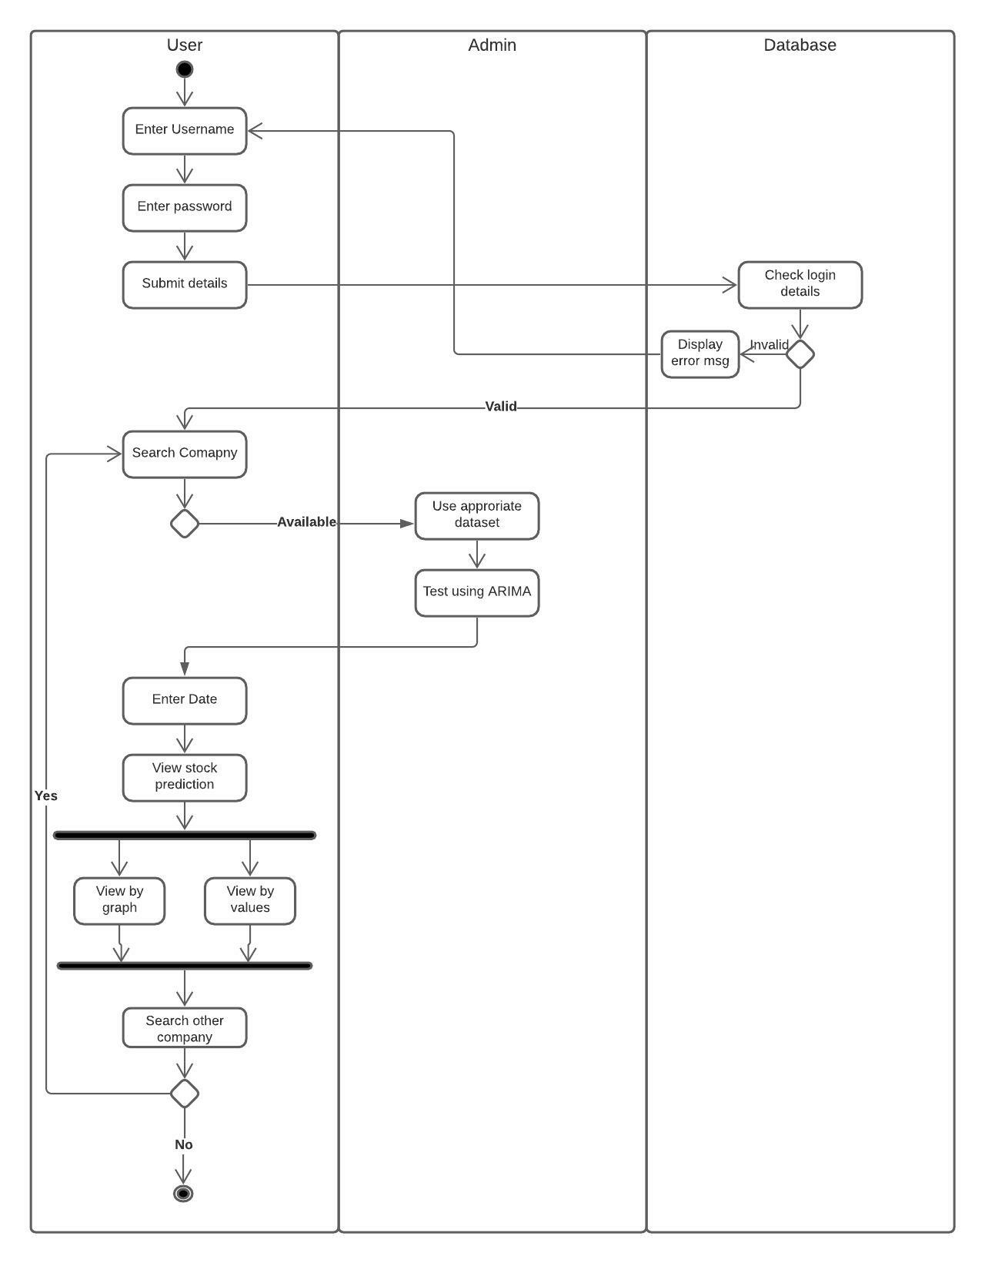
Activity Diagram

Slide 13
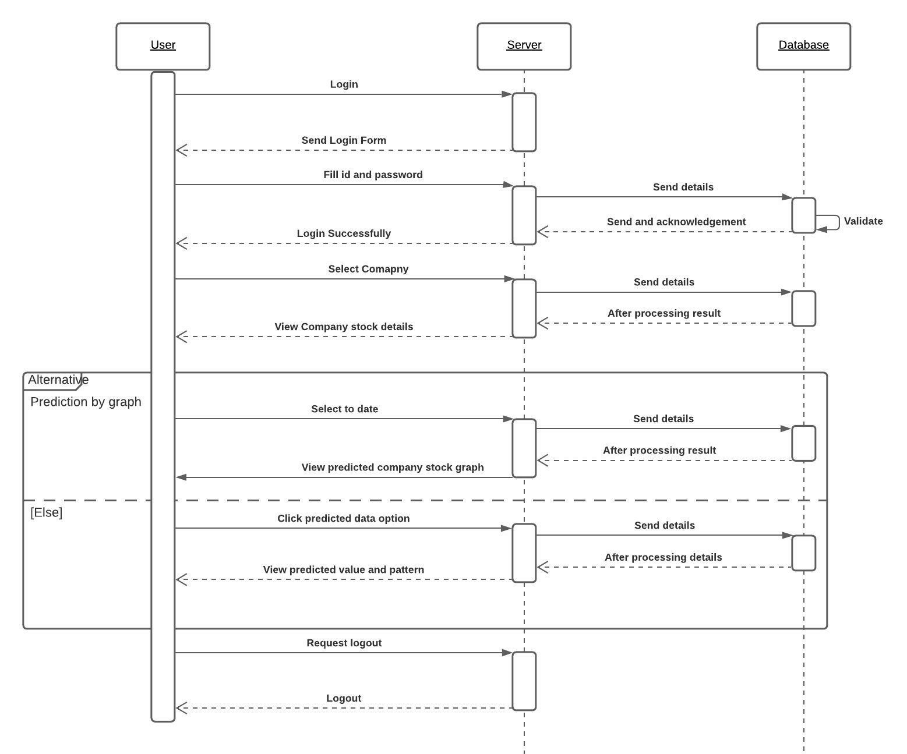
Sequence Diagram

Slide 14
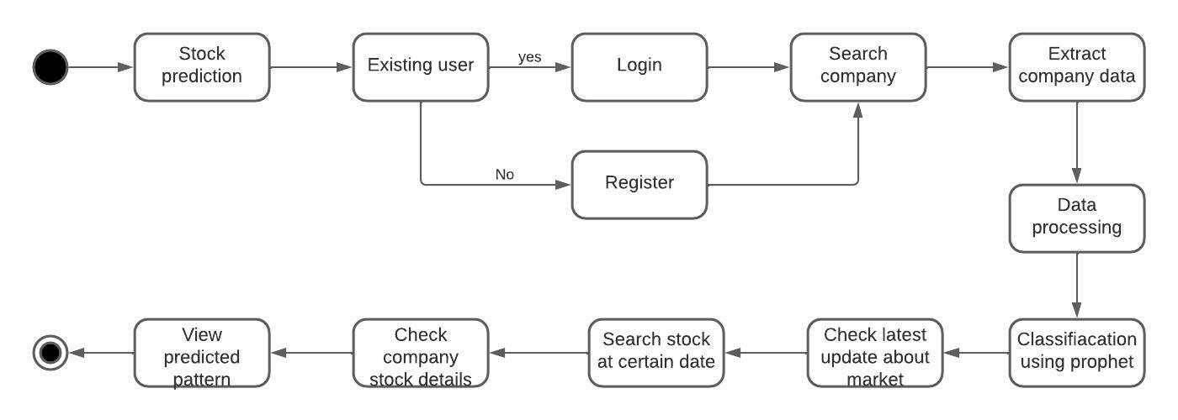
State Chart Diagram

Slide 15
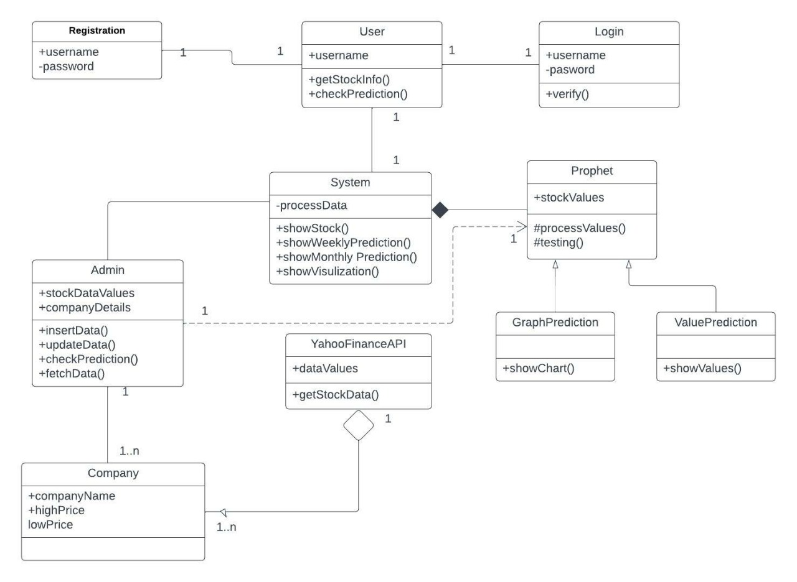
Class Diagram

Slide 16
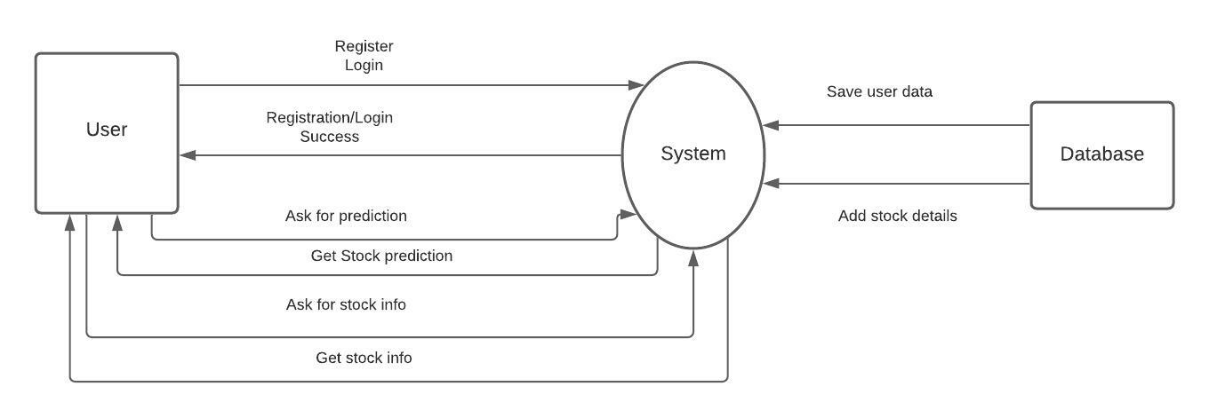
Data Flow Diagram

Slide 17
Technologies
Machine learning - Time series forecasting with the help of Facebook’s prophet
Data visualization
In graphical format
In tabular format

Slide 18
Functionalities
A website consisting of stock related information and prediction based on year.
Graphical representations of stock data, analyzed daily, weekly and monthly.
Forecasting the stock values from past values thorough yahoo fianance API , hence to plan for future investment.

Slide 19
Login/registration
Login and Registration is the entry point of an application.
All the user details will be asked to user if user is not registered.
Post registration, user needs to log in using his credentials.
Once logged in, user lands on the home page of the application.

Slide 20
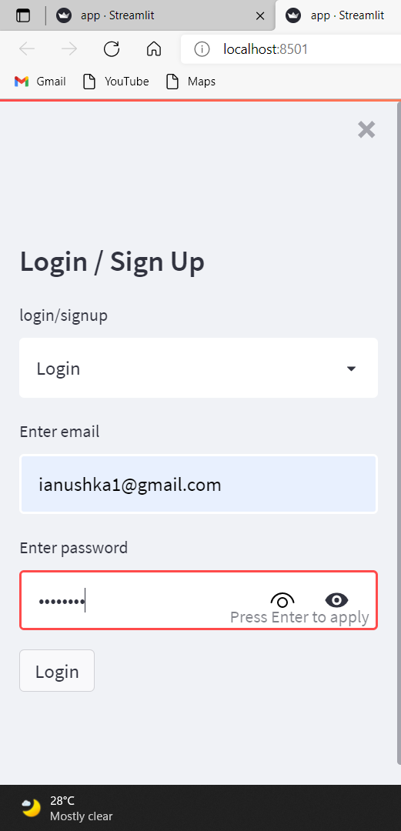

Slide 21
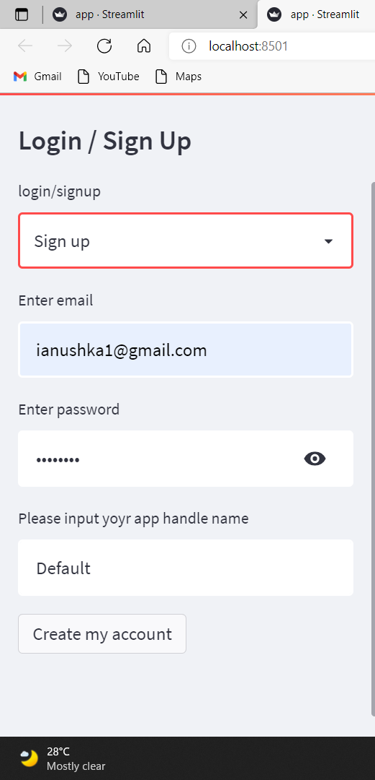

Slide 22
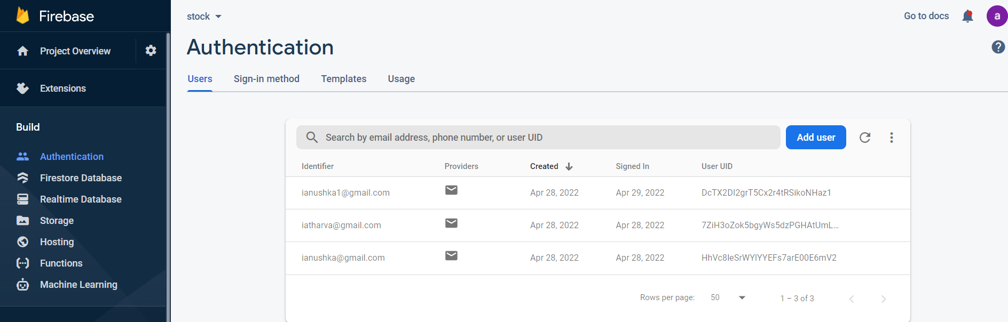
Firebase database Registered mail ids

Slide 23
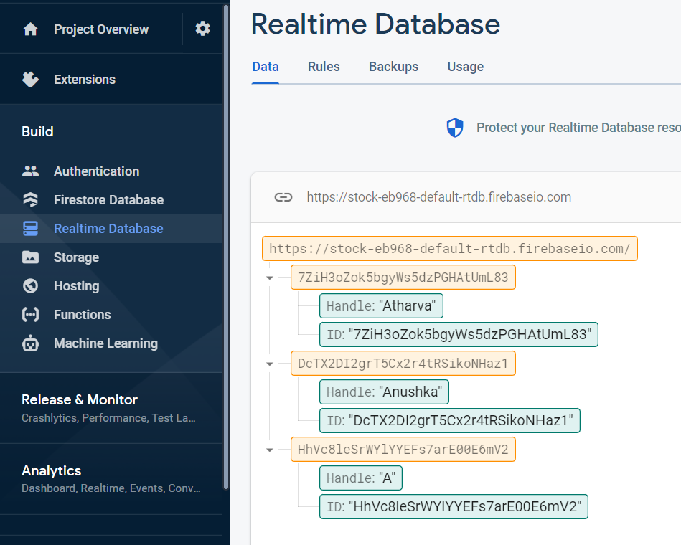
Firebase database Local id , handle name

Slide 24
Visualization
We’ve used streamlit for backend development.
Visualization is done by using plotly.graph_objs in python.
Forecasting of stock values is done using fbprophet algorithm.
We’ve used Pyrebase to access the data stored in firebase. Pyrebase is a Python interface which allows you to use python to manipulate your Firebase database.

Slide 25
Algorithm
Step 1 : Import the necessary python packages
Step 2 : Using ticker symbol, past 7 years of stock values are downloaded in a variable
Step 3 : certain figures such as figures with subplots of different types, dual-axis plots, or faceted plots with multiple different types of traces are created with Plotly.graph_objects.
Step 4 : fbprophet Function is applied on the data loaded.
Step 5 : Using predict function of fbprophet necessary values are forecasted and graph is ploted

Slide 26
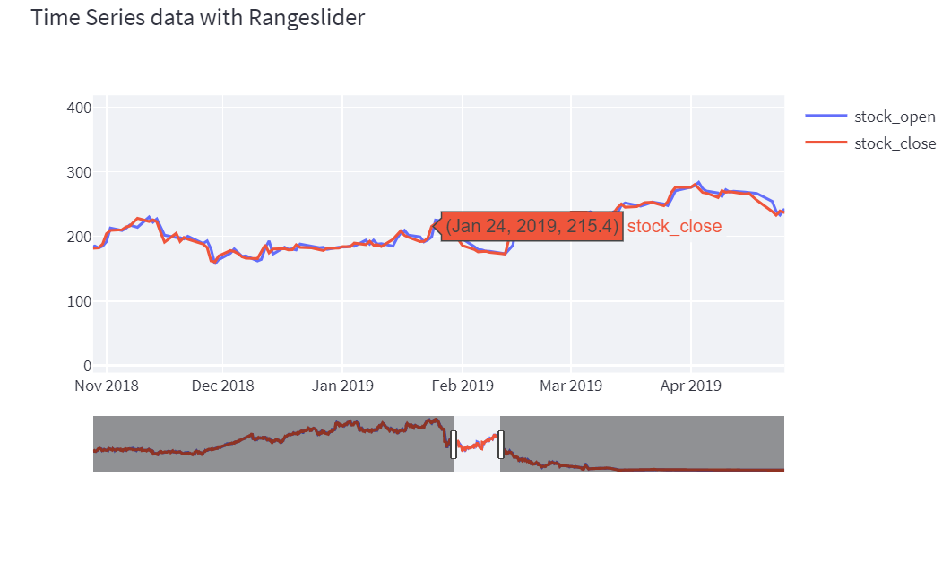
Prediction raw data with closing price

Slide 27
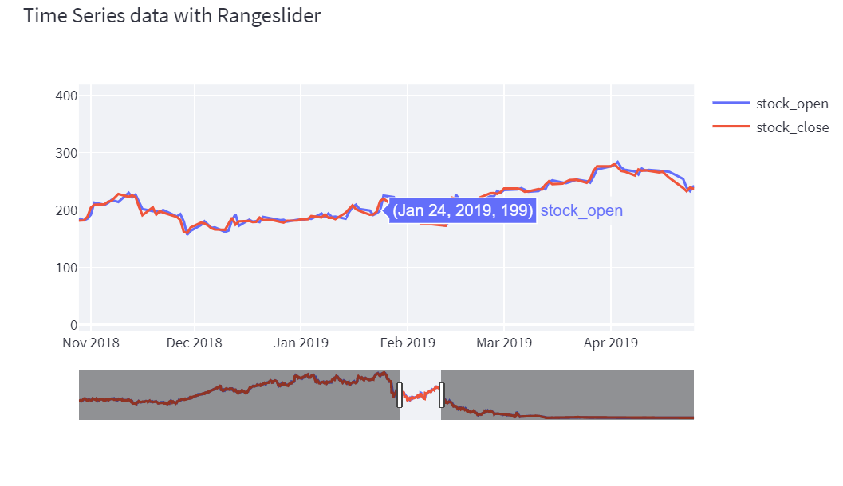
Raw data with opening price

Slide 28
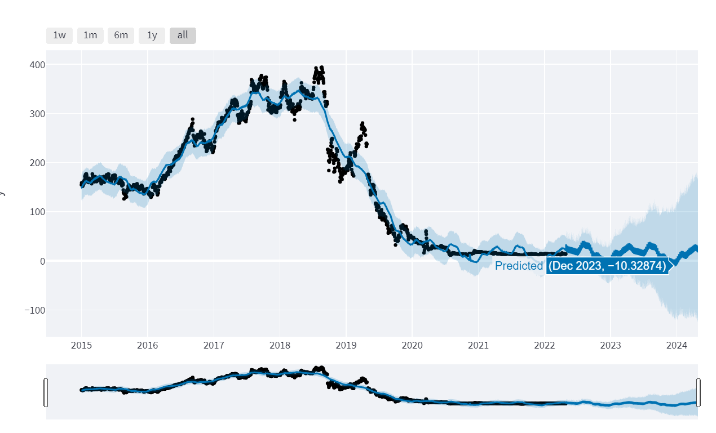
Prediction using Prophet

Slide 29
References
[1] Nifty 50 Yahoo Finance (https://in.finance.yahoo.com/quote/^NSEI/history/ )
[2] Ben letham. Prophet: forecasting at scale, https://research.facebook.com/blog/2017/02/prophet-forecasting-at-scale/
[3] Emir Žunić, Kemal Korjenić , Kerim Hodžić, and Dženana Đonko. Application of FB’s prophet algorithm for successful sales forecasting based on real-world data, https://arxiv.org/ftp/arxiv/papers/2005/2005.07575.pdf
[4] Yibin Ng. Forecasting Stock Prices using Prophet, https://towardsdatascience.com/forecasting-stock-prices-using-prophet-652b31fb564e
[5] Rohan Kumar. Predicting Stock Prices Using Facebook’s Prophet Model, https://medium.com/analytics-vidhya/predicting-stock-prices-using-facebooks-prophet-model-b1716c733ea6
[6] Ankit Chahal, Nishi Gupta. Stock closing price prediction, (https://www.irjmets.com/uploadedfiles/paper/volume_3/issue_7_july_2021/15270/final/fin_irjmets1628259873.pdf )

Slide 30
[7] Pavan Nagesh. Combination of Facebook Prophet and Attention-Based LSTM with MultiSource data for Indian Stock Market Prediction, (https://arrow.tudublin.ie/cgi/viewcontent.cgi?article=1248&context=scschcomdis ) [8] Rakshit Ratan. Stock Price Prediction with the help of python and fbprophet(prophet) library, (https://medium.datadriveninvestor.com/stock-price-prediction-with-the-help-of-python-and-fbprophet-prophet-library-part-1-3-f55ebff0b624 ) [9] (https://neptune.ai/blog/arima-vs-prophet-vs-lstm ) [10] ( https://www.analyticsvidhya.com/blog/2021/05/working-with-stock-market-time-series-data-using-facebook-prophet/ ) [11] Searafeim Loukas. Time-Series Forecasting: Predicting Stock Prices Using Facebook’s Prophet Model (https://ai.plainenglish.io/predicting-stock-prices-using-facebooks-prophet-model-b527ea8e445 )

Slide 31


